Slide 1
Chapter 3: HTML

Slide 2
Content
Markup and Rendering
Syntax of HTML

Slide 3
Markup and Rendering
A markup language uses set of annotations describe how a text is to be structured, laid out, or formatted
HTML is markup language
  Use tags <html>, <b>, <i>, …
  File extension: html, htm
Latex is a markup language
  Use environments, commands: \begin{equation}, \textcolor{}{} …
XML, WML …

Slide 4
Markup and Rendering
Rendering = visualize HTML document with web browser
Browser
  Is application that is installed on the client machine.
  reads the HTML source code and displays the page as instructed.
  Is used to display and navigate in web pages
  Popular browser: IE, Firefox
HTML editor
  Is required for create web page
  Useful editor: Microsoft FrontPage, Dreamwaver, …
  Basic editor: NotePad or any text editor

Slide 5
HTML syntax
Structure
Basic Tags

Slide 6
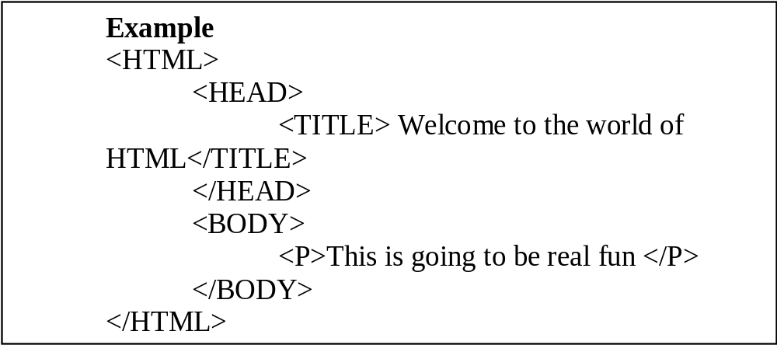
Structure of HTML document

Slide 7
Structure of HTML document
HTML Section:
  Every HTML document must begin with an opening HTML tag and end with a closing HTML tag.
  <HTML> … </HTML>
Head section:
  Optional
  <HEAD> … </HEAD>
  Contains document definition
  Contains page title which is displayed in navigation bar
Body section
  Contains what display in the web page

Slide 8
Basic tags
HTML uses tags for structuring and formating the document.
  Closed tags:
    <tag_name> … </tag_name>
    Ex: <body> …. </body>
  Open tags:
    <tag_name>…
    Ex: <BR>
  Attributes of tags
    <tag_name attribute=“value”>…
    Ex: <body bgcolor=“blue”> … </body>
  HTML is not case sensitive
HTML standard
  Validate a HTML document
    http://validator.w3.org/

Slide 9
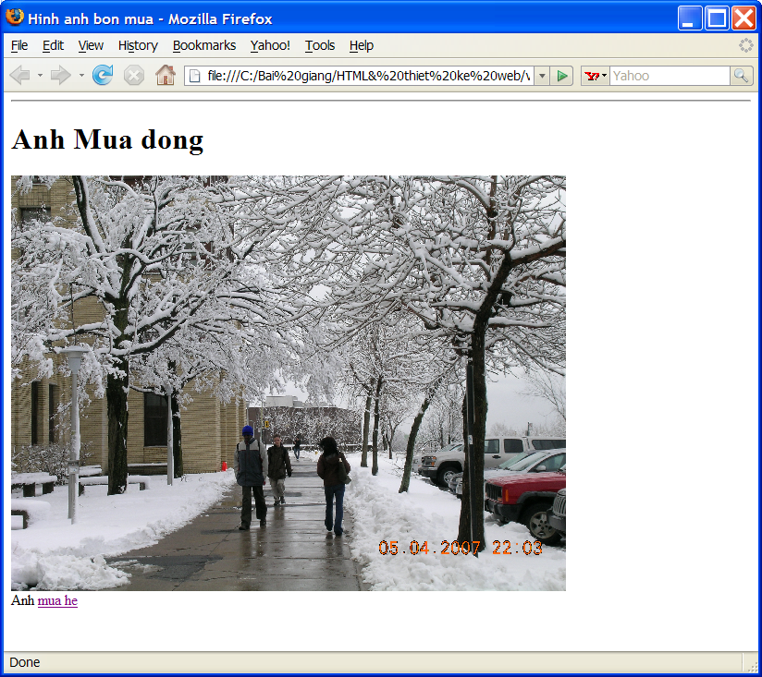
Tag <title>
Tag <title>
  Used inside <head>
  Displays the title of the page in the navigation
  <title>Hinh anh bon mua</title>

Slide 10
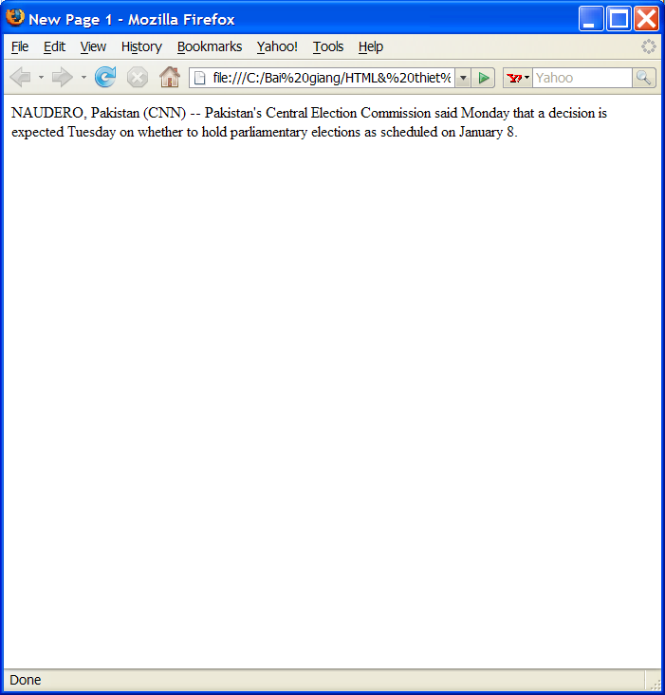
Text
Text is written inside <body>
Lines are broken automatically
Extra spaces are not shown
Ex:
<html>
<body>
NAUDERO, Pakistan (CNN)-- Pakistan's Central Election Commission said Monday that a decision is expected Tuesday on whether to hold parliamentary elections as scheduled on January 8.
</body>
</html>

Slide 11
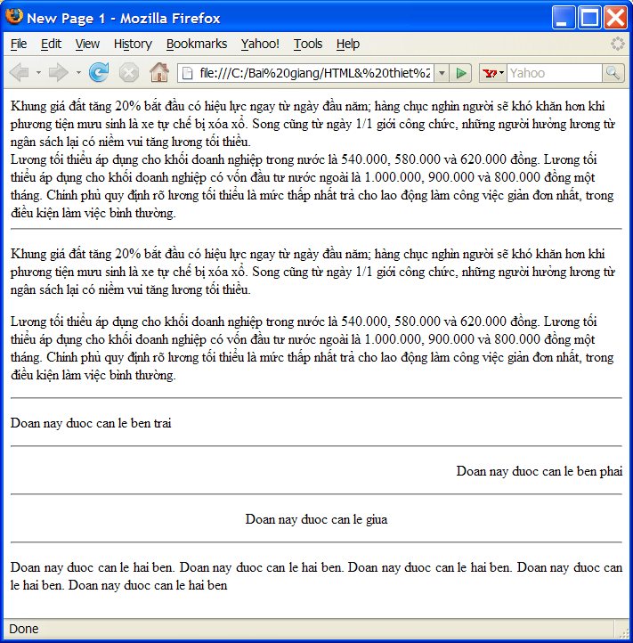
Text formatting tags
Line break:
  <BR> is added at the position where line is broken
Paragraph
  <p> a paragraph </p>
Align a paragraph
  <p align= “left”>
  <p align= “right”>
  <p align= “center”>
  <p align= “justify”>

Slide 12
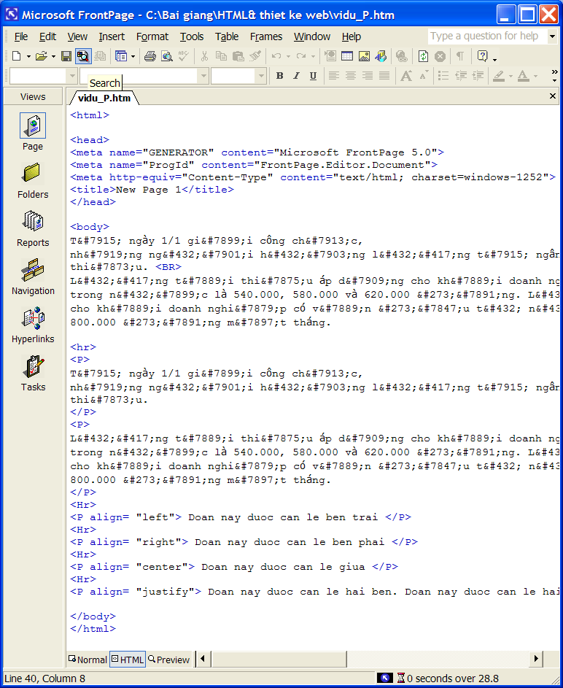
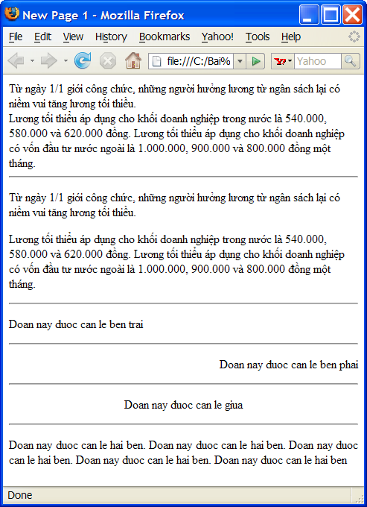
Text formatting tags

Slide 13
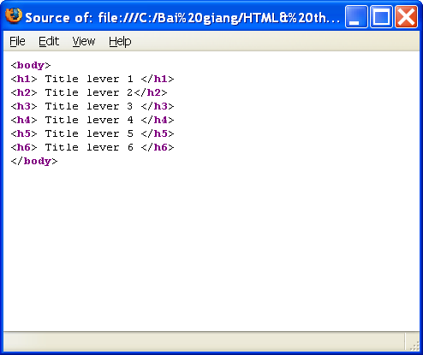
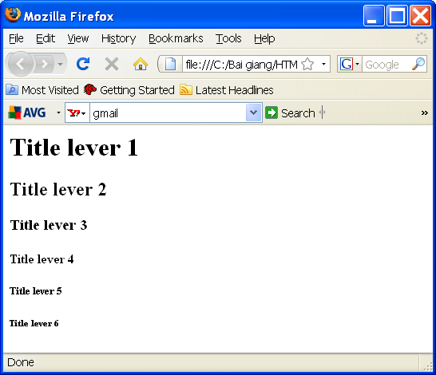
Text formatting tags
Heading tags: <h1> … <h6>

Slide 14
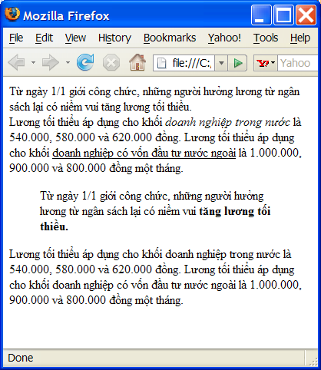
Text formatting tags
Character formatting tags
  <b>…</b>: bold character
  <i>...</i>: italic character
  <u>… </u>: underline character
  <!-- comment -->
  <blockquote> … </blockquote>

Slide 15
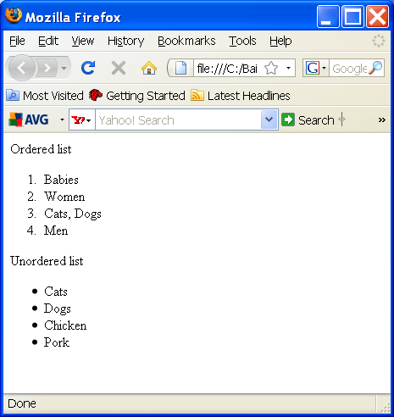
Lists
Ordered list
<ol>
<li>Babies</li>
<li>Women</li>
<li>Cats, Dogs</li>
<li>Men</li>
</ol>
Unordered list
  <ul>
  <li>Cats</li>
  <li>Dogs</li>
  <li>Chicken</li>
  <li>Pork</li>
  </ul>

Slide 16
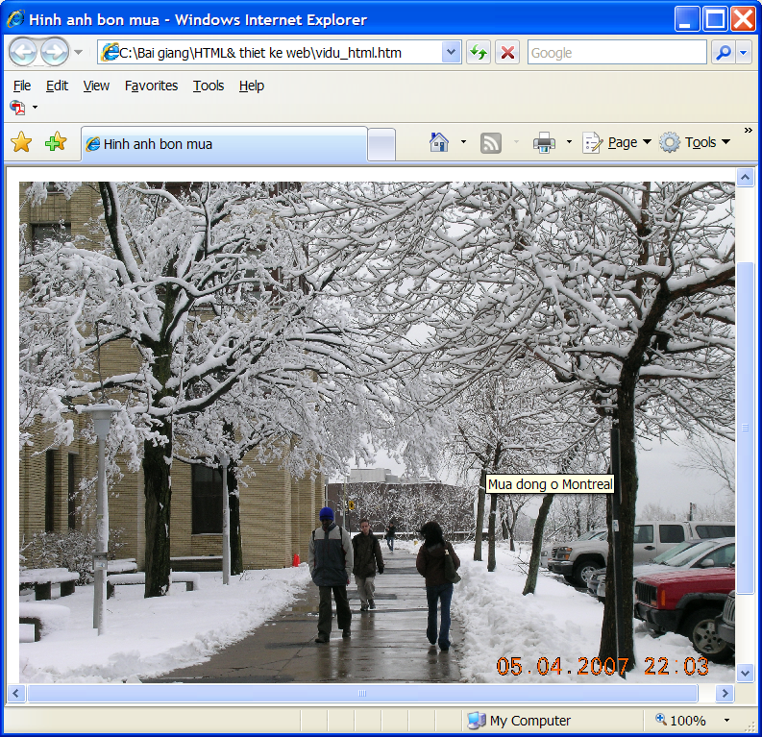
Insert images
<IMG SRC=“winter.jpg" width="600">
  Attributes
    Src: URL of the image
      Absolute address
      Relative address
    Width:
    Height:
      Absolute: Pixel
      Relative: % in comparison with page size
    Alt: description of the image that will be displayed when placing mouse on the image

Slide 17
Table
Tag <table>
  Contains rows
    <tr>… </tr>: presents a row
    Each row contains multiples cell of data, each one belongs to a column
      <td> bla bla bla </td>
    <th>…</th>: the first row is written in bold characters
      Used for displaying the title of each column

Slide 18
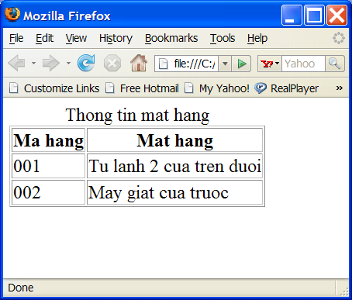
Table - Example
<table border="1">
<caption> Thong tin mat hang </caption>
<tr>
<th>Ma hang</th>
<th>Mat hang</th>
</tr>
<tr>
    <td>001</td>
    <td>Tu lanh 2 cua tren duoi </td>
</tr>
<tr>
    <td>002</td>
    <td>May giat cua truoc </td>
</tr>
</table>

Slide 19
Background
Define color of the background
  Background with unified color
    <body bgcolor="#000000">
    <body bgcolor="rgb(0,0,0)">
    <body bgcolor="black">
Background image
  Image is used for background
    <body background="clouds.gif">
    <body background="http://www.w3schools.com/clouds.gif">
  Image will be repeated for filling the background if it is smaller than the size of the web page
Text color
  <body text=“red”>

Slide 20
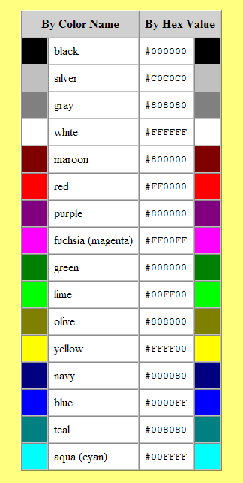
Basic colors
Color name or code can be used alternatively
Ex:
  <body bgcolor = “red” text=“white”>
  <body bgcolor = “#FF0000”>

Slide 21
Hyperlink
External hyperlink
  Hyperlink with another
    <a href=“url”> Displayed Text</a>
    Href: URL of the web page that will be linked to
    Text within tags <a> will be normally underlined and when it is clicked on, the page in href will be displayed
Relative address
  <a href="../link1.html">A page</a>
Absolute address
  <a href=“http://fit.hut.edu.vn/link1.html">Another page</a>

Slide 22
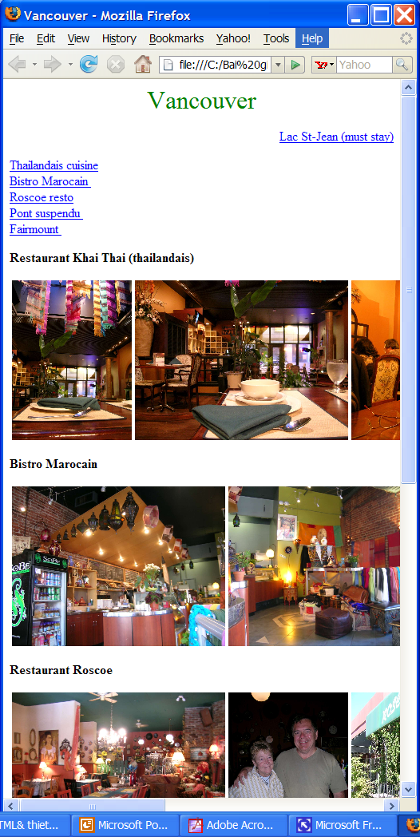
Hyperlink
Internal link
  Link to a section of the same page
  Assign a name to the section →Bookmark it
  <a name=“rosco">Restaurant Roscoe </a>
  Make the link
  <a href="#rosco"> Roscoe resto</a>
  Example

Slide 23
Hyperlink
Attribute target
  Define the position where the liked page will be displayed
  <a href=“url" target=“pos"> …</a>
    pos=“ _blank”
      Display the linked page in a new window
      <a href="http://www.w3schools.com/" target="_blank">Visit W3Schools!</a>
    pos=“_self”
      Display the linked page in the current window
      <a href="http://www.w3schools.com/" target=“_self">Visit W3Schools!</a>

Slide 24
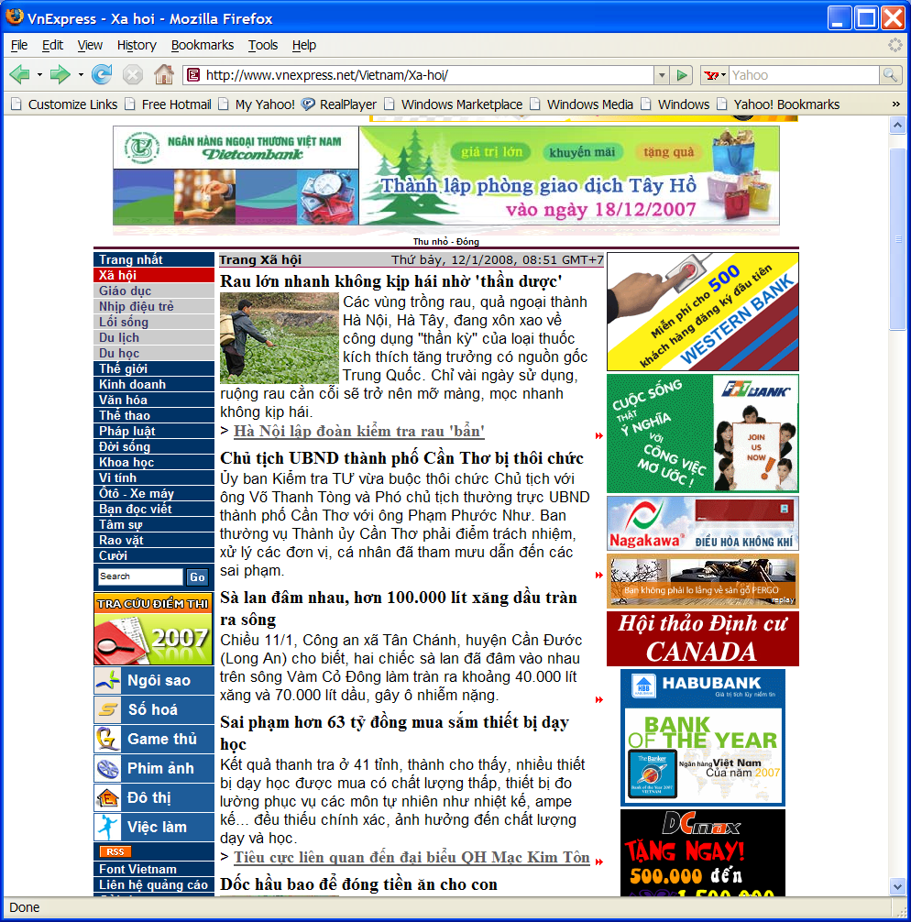
Synthesis example

Slide 25
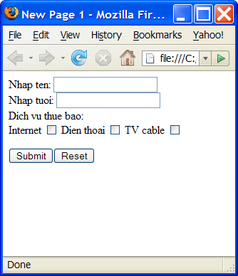
Form
Form allows to interact with users
A form contains labels and corresponding data fields
  Label describes the meaning of the data field
A program can be called when the data fields are submitted

Slide 26
Form
Form tag
  <form method =“…” action =“…” name =“…”>
  …
  </form>
  Method:
    Get:
      Data will be added in clear in the URL and displayed in the address bar of the navigator
      The length of data is not over 255 characters
    Post:
      Data is hidden
      The length of data is unlimited
  Action: address of the program in server that will be executed
    CGI, APS, PhP
    Dynamic web on server side

Slide 27
Form
Label
  <label for="ten">Enter your name:</label>
  Label for the data field where user needs to fill name
Data field types
  Text
  Password
  Hidden
  Checkbox
  Radio
  Select
  Select multiple
  Textarea
  Submit
  reset

Slide 28
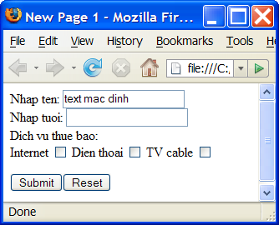
Text
Many data field types can be defined by tag <input>
  <input type =“…” name =“…” id=“…” value =“…”>
  Type: text, password, hidden, button, checkbox, radio
Using “input” for defining a text box
<input type=“text” value =“text mac dinh” name=“ten” size =“20”>
  Size= width of the text box
  Value= value displayed in the text box

Slide 29
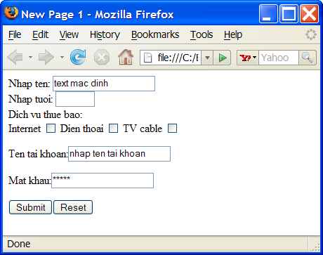
Password, Hidden
<input type=“password” value =“secret” name = “p” size =“20”>
  Characters are replayed by *
<input type=“hidden” name =“name” value =“James Smith” size =“20”>
  The field is not displayed in the page
  Hidden input is used for transferring parameters from form to server.

Slide 30
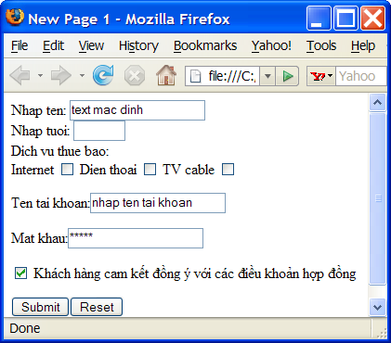
Checkbox
Checkbox allows to make multiples choices in a defined set of options
Each checkbox is a option
Option in the same sets must have the same name.
<input type="checkbox" name=“service" id ="internet" value ="1">
<input type="checkbox" name=“service" id=“telephone" value ="2">
<input type="checkbox" name =“service" id ="cable" value ="3">
internet <--> dichvu[0]
telephone <--> dichvu[1]
cable <--> dichvu[2]
Check an option
  <input type="checkbox" name=“cam_ket” value=“OK“ checked>

Slide 31
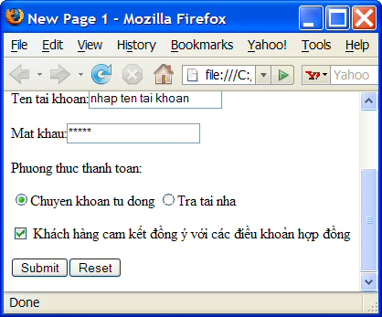
Radio
Radio button allows to choose an unique choice among pre-defined options.
Options in the same sets must have the same name.
<input type="radio" name=“payment“ value=“automatic" checked> Chuyen khoan tu dong
<input type="radio“ name=“payment" value=“home"> Tra tai nha

Slide 32
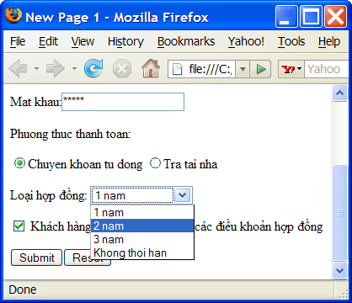
Select
<Select> allows to make a list of options with unique choice in a pop up list
Each option is presented by <option>
<select name=“…">
  <option> … </option>
  <option> … </option>
  <option> … </option>
  <option> … </option>
</select>
Example
<select size="1" name="hopdong">
  <option>1 nam</option>
  <option>2 nam</option>
  <option>3 nam</option>
  <option>Khong thoi han</option>
</select>

Slide 33
Select multiple
Select multiple allows making a list of options with multiple simultaneous choices
Select multiple is created by adding attribute multiple in <select>
<select name=“…“ multiple>
  <option> … </option>
  <option> … </option>
  <option> … </option>
  <option> … </option>
</select>

Slide 34
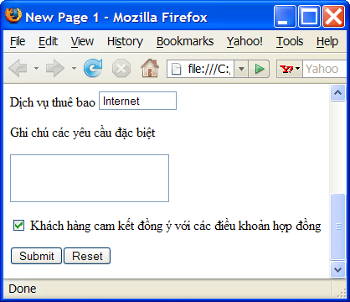
Textarea
<Textarea> creates a a region that may compose of multiple lines to enter.
<textarea name="S1“ rows="2" cols="20">
……
</textarea>
cols: the width of the area in number of characters
Rows: number of rows

Slide 35
Submit, reset, button
Submit
  Button for submitting data fields in a form to a program specified in action attributes of <form>
    <input type="submit" value="Submit">
Reset
  Make data fields in form back to their initial states
  <input type="reset" value="Reset">
<Button>
  Allows to create a general purpose button
    <button name="B3">Xem hop dong</button>
  Type “button” of <input> allows to make equivalent button
    <input type=“button” name = “B3” value=“Xem hop dong”>

Slide 36
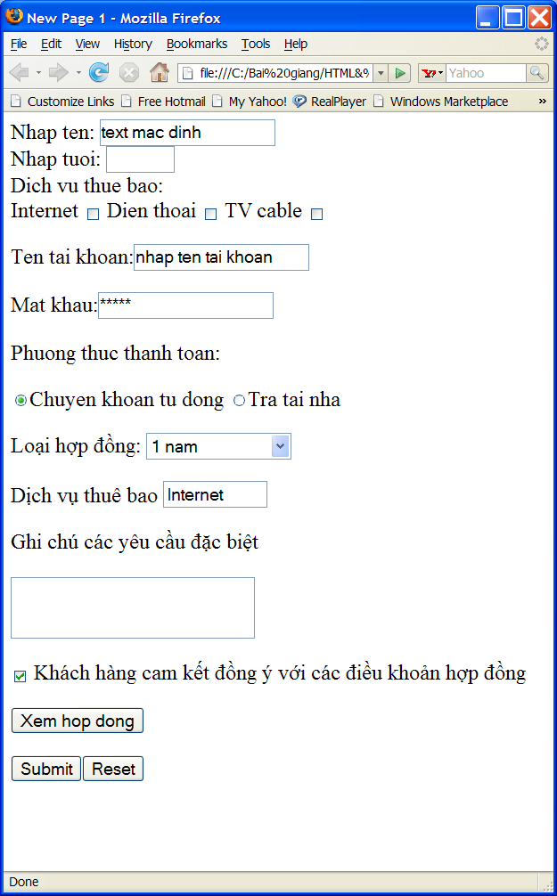
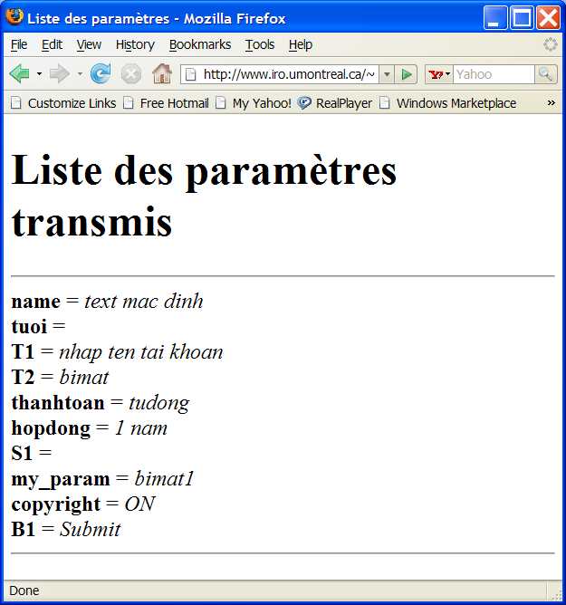
Example

Slide 37
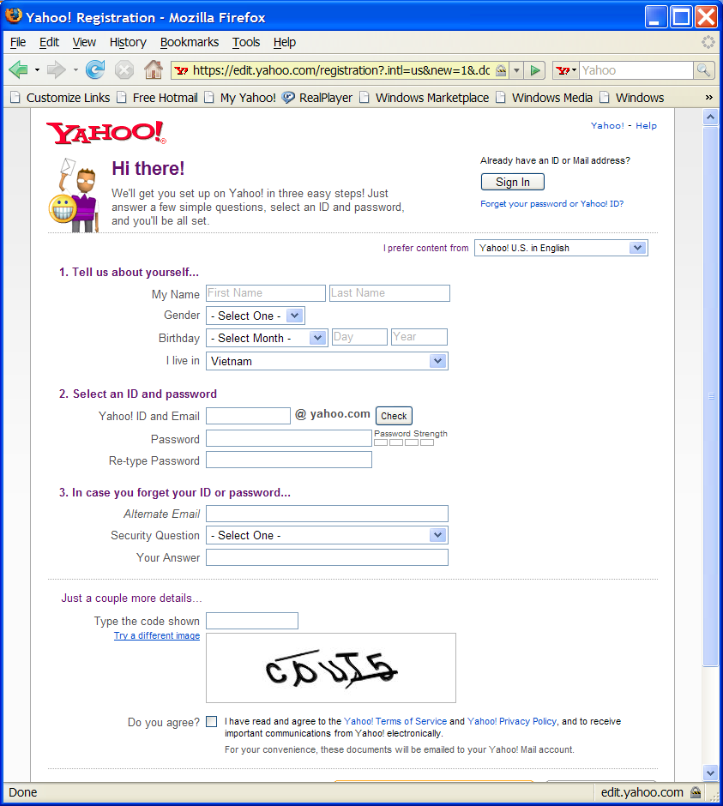
Ví dụ

